Slide 1
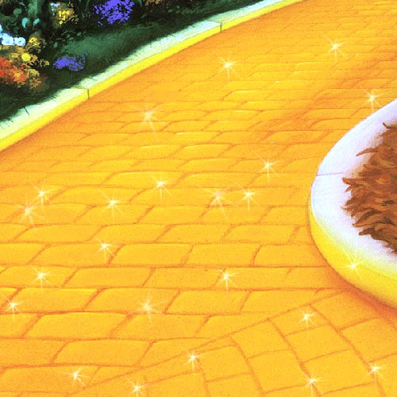
These words can make your writing even better!
Follow the
Yellow Brick Words…
Image taken from Google Images

Slide 2
Students will help generate words to replace the generic words on each slide below. Teacher will write them on yellow rectangles and then display to the right of each slide below to form a yellow brick road of words.
peek
stare
glance
glare
scowl
gaze

Slide 3
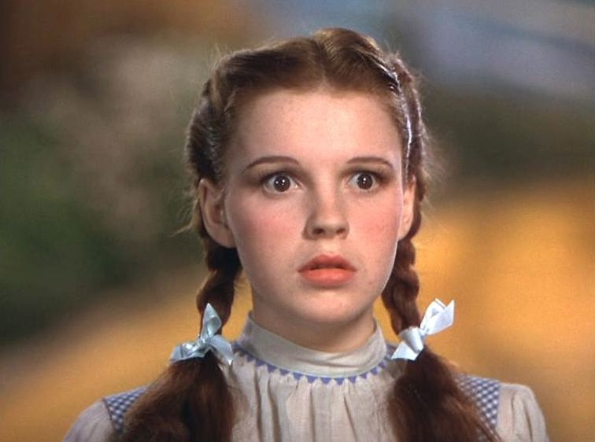
Image taken from Google Images
Instead of
look
Use these words…

Slide 4
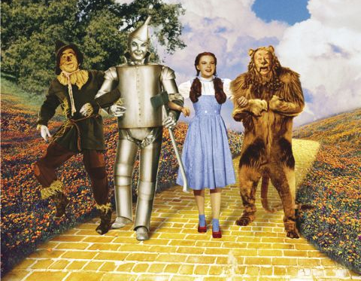
Image taken from Google Images
Instead of
walk
Use these words…

Slide 5
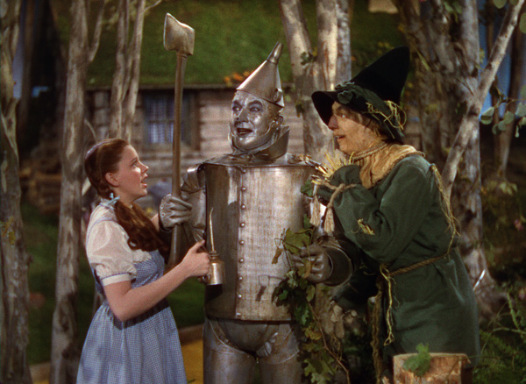
Image taken from Google Images
Instead of
said
Use these words…

Slide 6
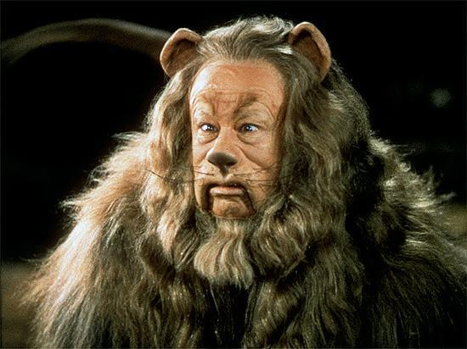
Image taken from Google Images
Instead of
mad
Use these words…

Slide 7
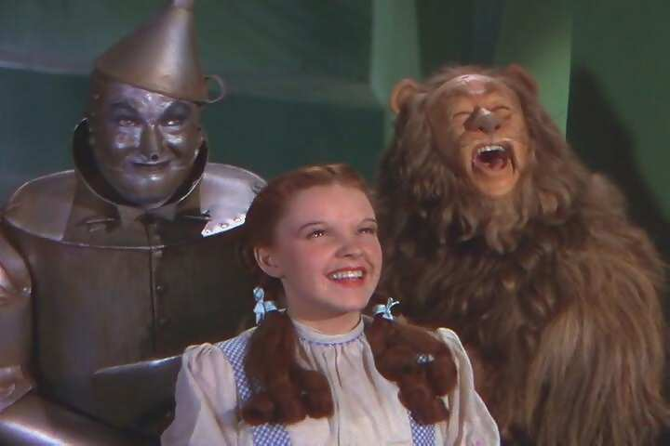
happy
Image taken from Google Images
Instead of
Use these words…

Slide 8
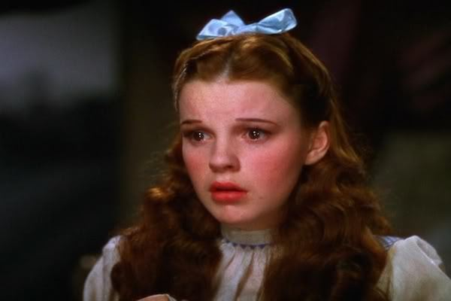
Instead of
Image taken from Google Images
sad
Use these words…

Slide 9
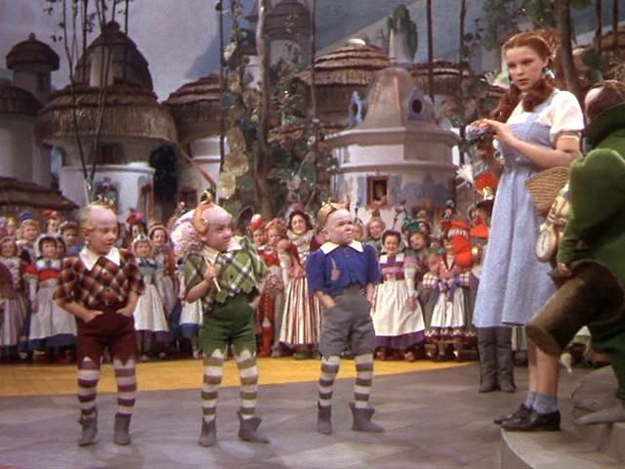
Image taken from Google Images
Instead of
little
Use these words…

Slide 10
Image taken from Google Images
Instead of
big
Use these words…

Slide 11
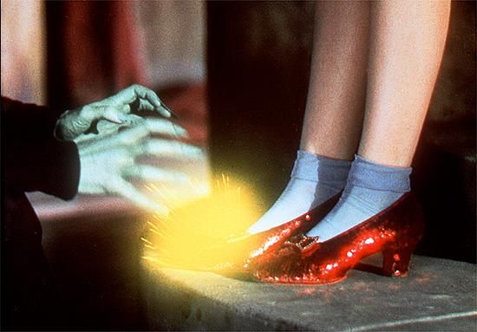
take
Image taken from Google Images
Instead of
Use these words…

Slide 12
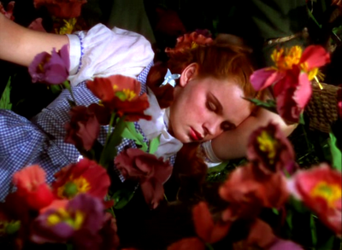
Image taken from Google Images
Instead of
sleep
Use these words…

